Slide 1


Principles of Database System 《数据库系统原理》
关佶红 / Jihong Guan
教授、博导 / Professor
Email: jhguan@tongji.edu.cn

Slide 2
About the Course
Credit units：3
Lecture hours：51 (理论与课堂研讨)
Practice hours：16 (实验课8次)
Long term: 17 weeks (配套2024春课程设计)
Instructors: 关佶红、张毅超、李文根
TAs：
彭瀚：18010699229，penghan@tongji.edu.cn
金唱：17721293653，jinchang1223@tongji.edu.cn
汪宇晗：18365131329，2331925@tongji.edu.cn
宋子涵：13386457589，2331902@tongji.edu.cn
蒋旭东：18234867925，xdjiang@tongji.edu.cn

Slide 3
Contacting the Instructors-1
Prof. Guan Jihong (关佶红)
ADMIS Lab: Room 429B, DianXin Building, Research: Data Management, Data Mining, Big Data, Machine Learning, AI, Bioinformatics, et al
Lecture hours: Mon.10:00~11:35(Odd),Wed.10:00~11:35 （博楼B414）
Office: Room 429B/458/403, DianXin Building, Jiading campus
Office Hour: Mon.12:30-16:00, Wed.13:00-15:00
Online: Tencent Meeting, ML/AI/BD/Bioinfomatics
Tel: 186-1610-2875; Email: jhguan@tongji.edu.cn
Homepage: http://admis.tongji.edu.cn/

Slide 4
Contacting the Instructors-2
Associate Prof. Yichao Zhang (张毅超)
Lecture Hours: Mon.10:00~11:35(Odd), Wed.10:00~11:35 (教学楼G108)
Office Hours: Tue. 13:30-16:30, Thu.13:30-16:30 (智信馆458)
Tel: 15021825768; Email: yichaozhang@tongji.edu.cn
Online: Email, Wechat
Research interests: Graph neural networks, link prediction, weighted network modeling, random diffusion, network games, financial data analysis, and urban disaster prevention.
Homepage

Slide 5
Contacting the Instructors-3
Assistant Prof. Li Wengen (李文根)
ADMIS Lab: Room 429B, DianXin Building, Research: Data Management, Data Mining, Big Data, Machine Learning, AI, Bioinformatics, et al
Lecture hours: Mon.10:00~11:35(Odd), Wed.10:00~11:35
Office Room: 429B, 智信馆
Office Hour: Tue. 13:30-16:30, Thu.13:30-16:30
Tel: 15000621786; Email: lwengen@tongji.edu.cn
Online: QQ, Email
Research interests: Spatio-temporal data management and analytics, multi-modal intelligence, knowledge graph
Homepage

Slide 6
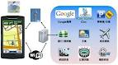
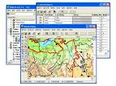
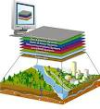


Our research
Data management, Date Mining, Big Data, Machine Learning
Spatio-temporal data analytics, multi-modal intelligence
Knowledge graph, AI, Intelligent Services
Image Processing
Bioinformatics
Complex Networks

Slide 7
大数据管理与智能服务相关主要研究与应用
大数据
智能分析
时空
大数据
生物医学
大数据
海洋
大数据
工业
大数据
产业
大数据
网络
大数据
实验室相关研究成果发表在国际顶级会议和期刊上，如Nature Communications, VLDB, VLDBJ, TKDE, NAR, Bioinformatics, SIGMOD,ICDE, EDBT, ISMB, RECOMB，AAAI，CVPR，SIGKDD，ACM MM，ICCV, IEEE/ACM Trans……

Slide 8
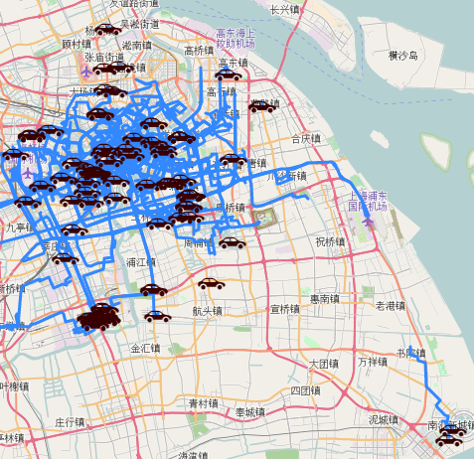
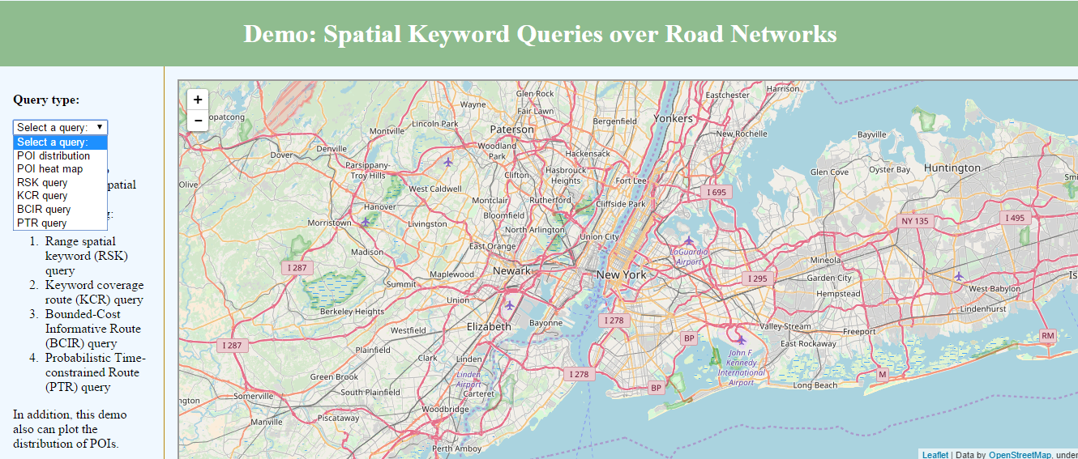
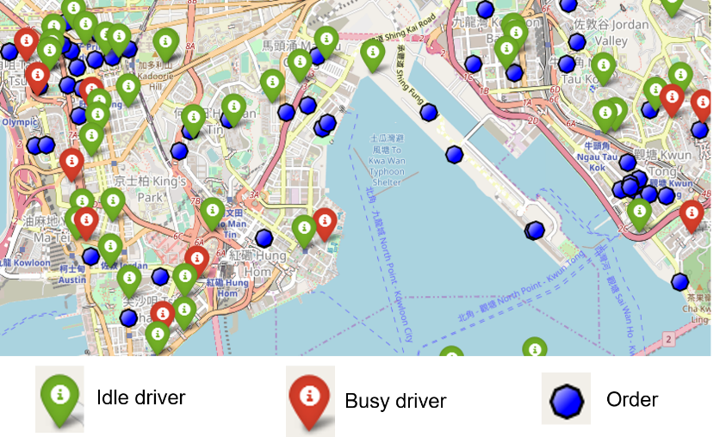
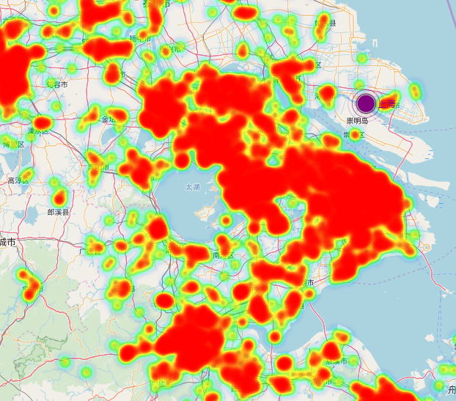
Spatial Data Management & Analysis
城市交通工具分时租赁、基于路网的城市服务查询、全国产业集群分析、空间位置提取与定位等
交通工具分时租赁
基于路网的城市服务查询
基于地理的产业集群分析
空间位置提取与定位

Slide 9
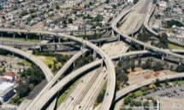
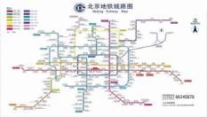
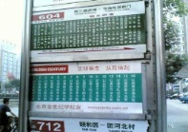
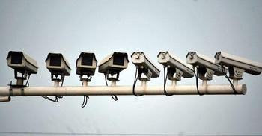


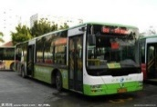
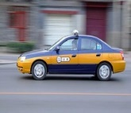
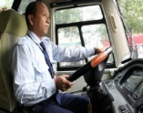
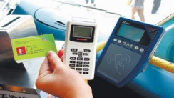
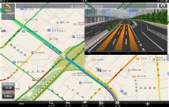

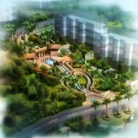
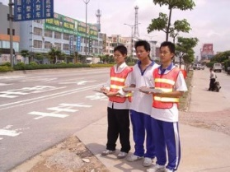





Transportation related Data
交通基础数据Basic Data
动态运行数据Dynamic Data
基础设施
Infrastructure
交通检测数据
Detection Devices
车辆和人员
Vehicles and Employees
交通行为数据
Behavior Data
城市活动数据Context Data
交通调查数据Census Data
人口、土地、经济
Population, Land, Economics
综合交通调查
Comprehensive Census
气象、环境等
Weather, Activities
Transportation Economic Census

Slide 10
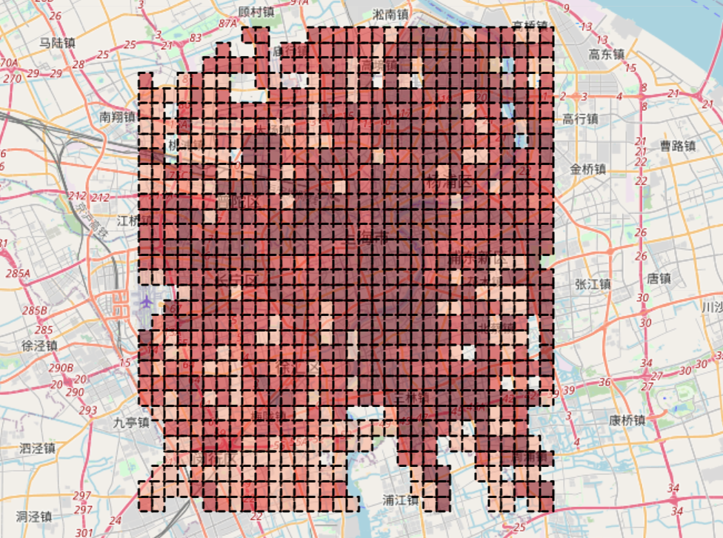
上海中心城区交通规律性量化
颜色越深，规律性越大

Slide 11
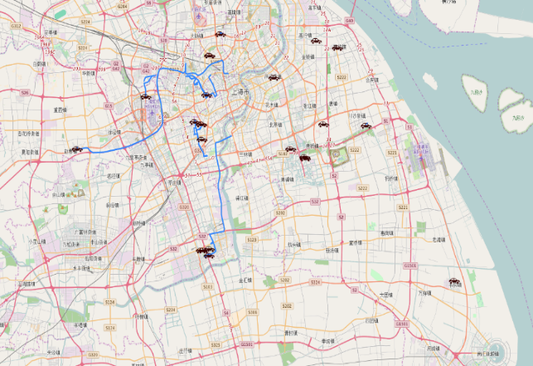
车辆分时租赁优化
交通大数据的数据平台，为车辆分时租赁交通物联网大数据处理平台提供技术支持。
后台处理
框架
Flume
Kafka
Spark
Redis
前台处理
框架
OpenStreetMap
Leaflet
Apache
单台电动车行车轨迹
多台电动车行车轨迹

Slide 12
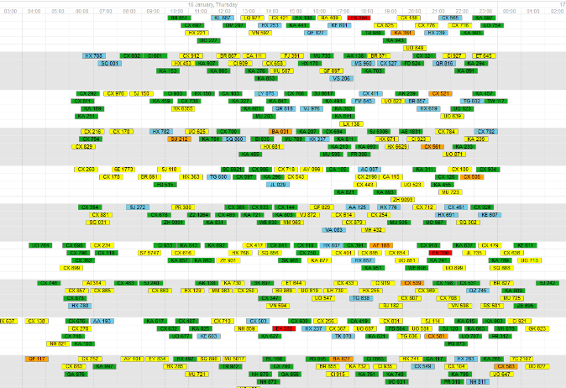
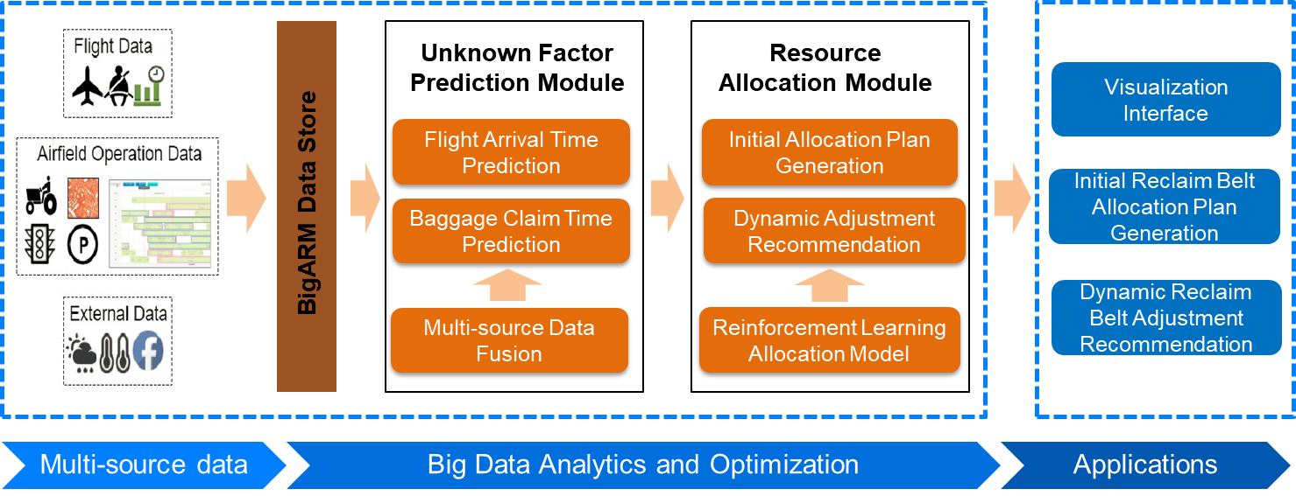
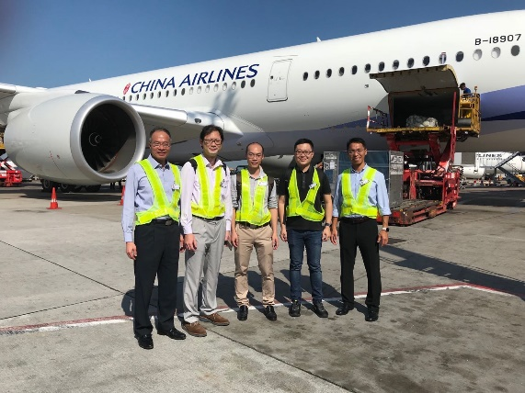
机场行李处理优化
项目内容
利用大数据分析技术优化香港国际机场停机位、行李装卸车、行李拖车、行李传送带以及停机坪员工等资源的分配和使用，提高资源的分配效率(秒级整体分配方案生成)和资源使用的均衡性(20%+)

Slide 13

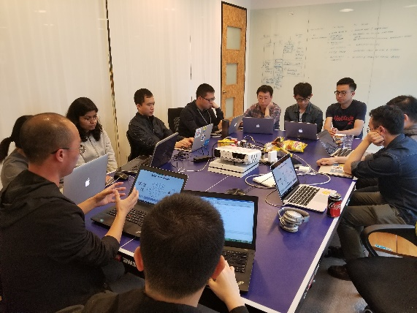
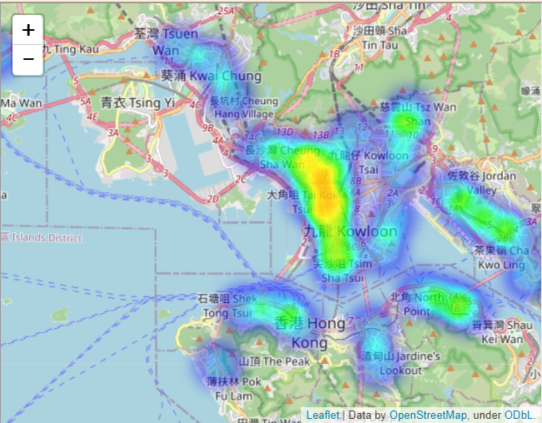
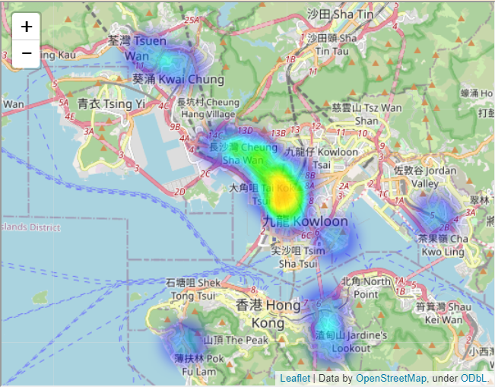
货物订单需求预测、订单分配优化
项目内容
融合多源异构数据（历史订单数据、交通数据、天气数据、用户数据），解决了按需货物运输服务中需求与供应的时空分布不均衡问题
货物运输订单需求预测、订单分配优化
GoGoVan: 提高6%的有效订单完成率
按需货物运输平台
香港首个市值10亿美元的独角兽
+6%
1200订单
优化前未完成订单
优化后未完成订单

Slide 14
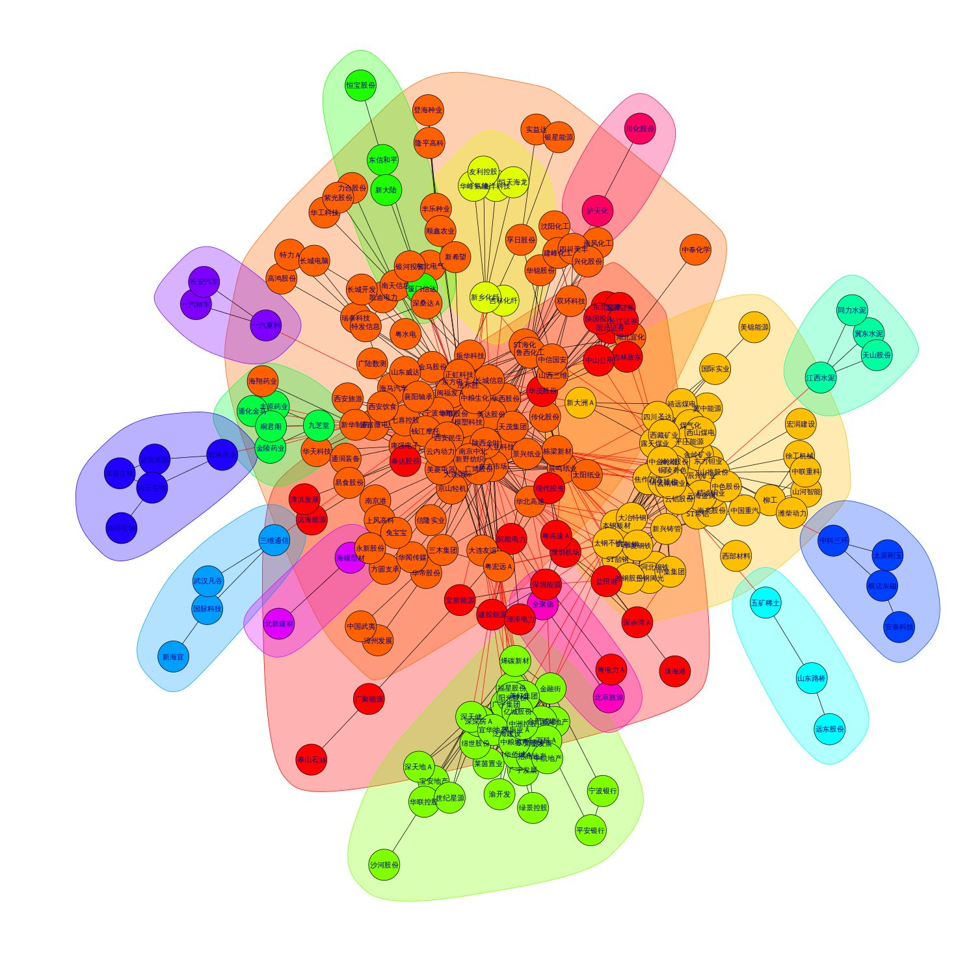


供应链知识图谱构建
项目内容
结合自然语言处理技术构建深度学习模型，挖掘全国大中小企业的供应关系，构建面向供应链的专业知识图谱
2000万+ 企业
数据源：行业研报、企业研报、招股说明书、招投标公告

Slide 15
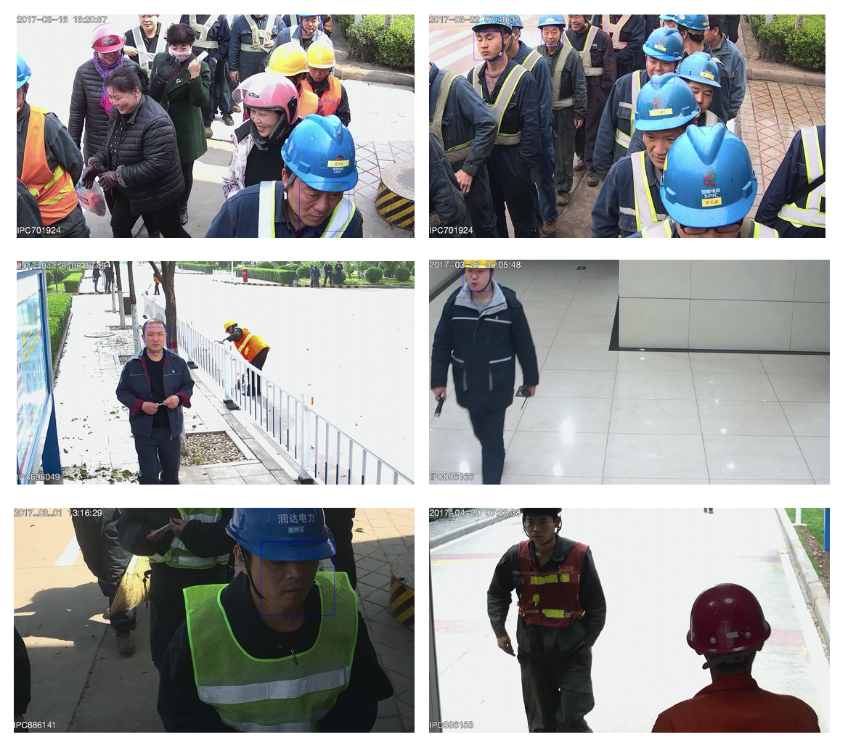
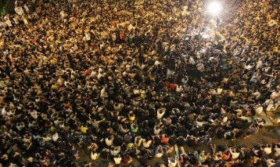
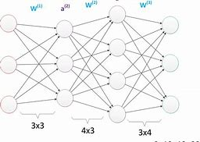
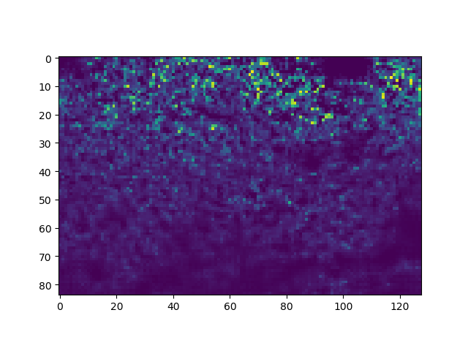
厂区监控视频安全检测
厂区人群密度估计
厂区穿戴规范检查
原始图
深度网络
预测密度图
人群计数

Slide 16
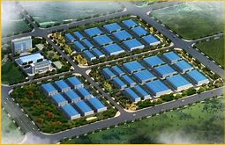

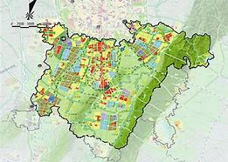

产业园区监测与管理
显示园区基本概况，包括基本信息：地理坐标、范围、介绍、行政区划、级别、园区类型、主导产业、生产要素等信息。
监测园区信息
显示园区内各个企业分布、企业信息包括地理坐标、范围、所属行业、工业产值、业务增长率、利润、员工人数
监测企业信息
建立产业集群的概念，并实现产业集群的发展情况的分析，展示集群的产业发展状况、企业分布情况、园区分布情况、产业资源分布情况
监测产业集群信息
数据分析
实现对比分析、交叉分析及预测分析功能。

Slide 17
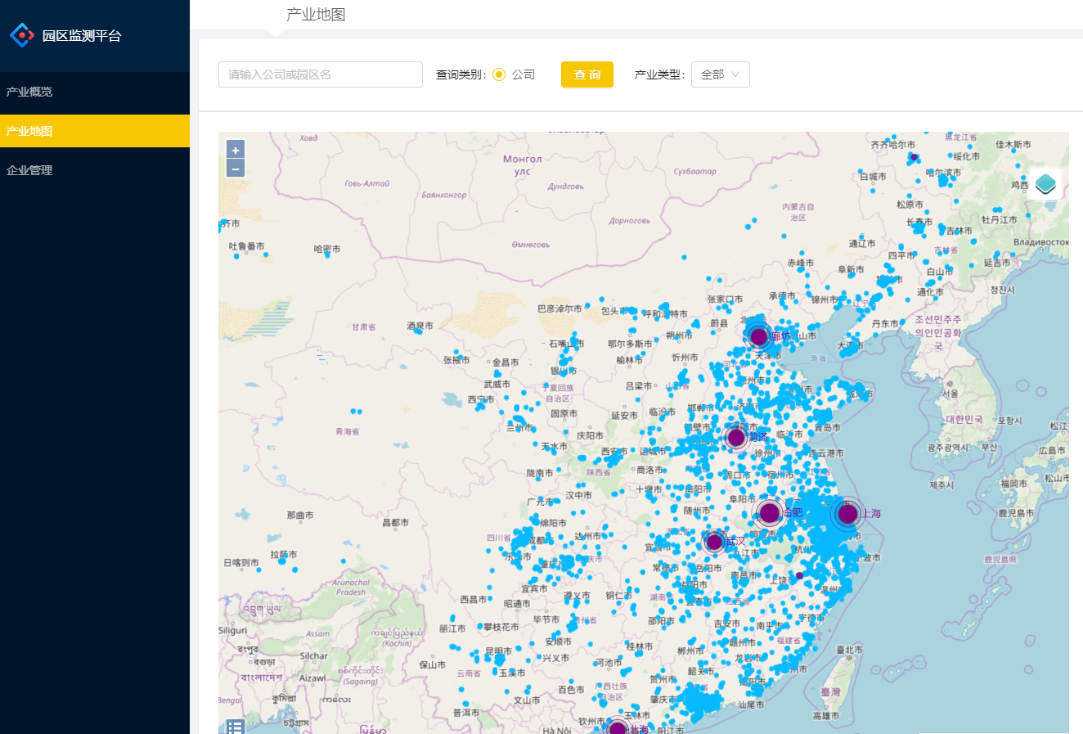

基于 WebGIS 的产业集群监测平台
项目合作

Slide 18
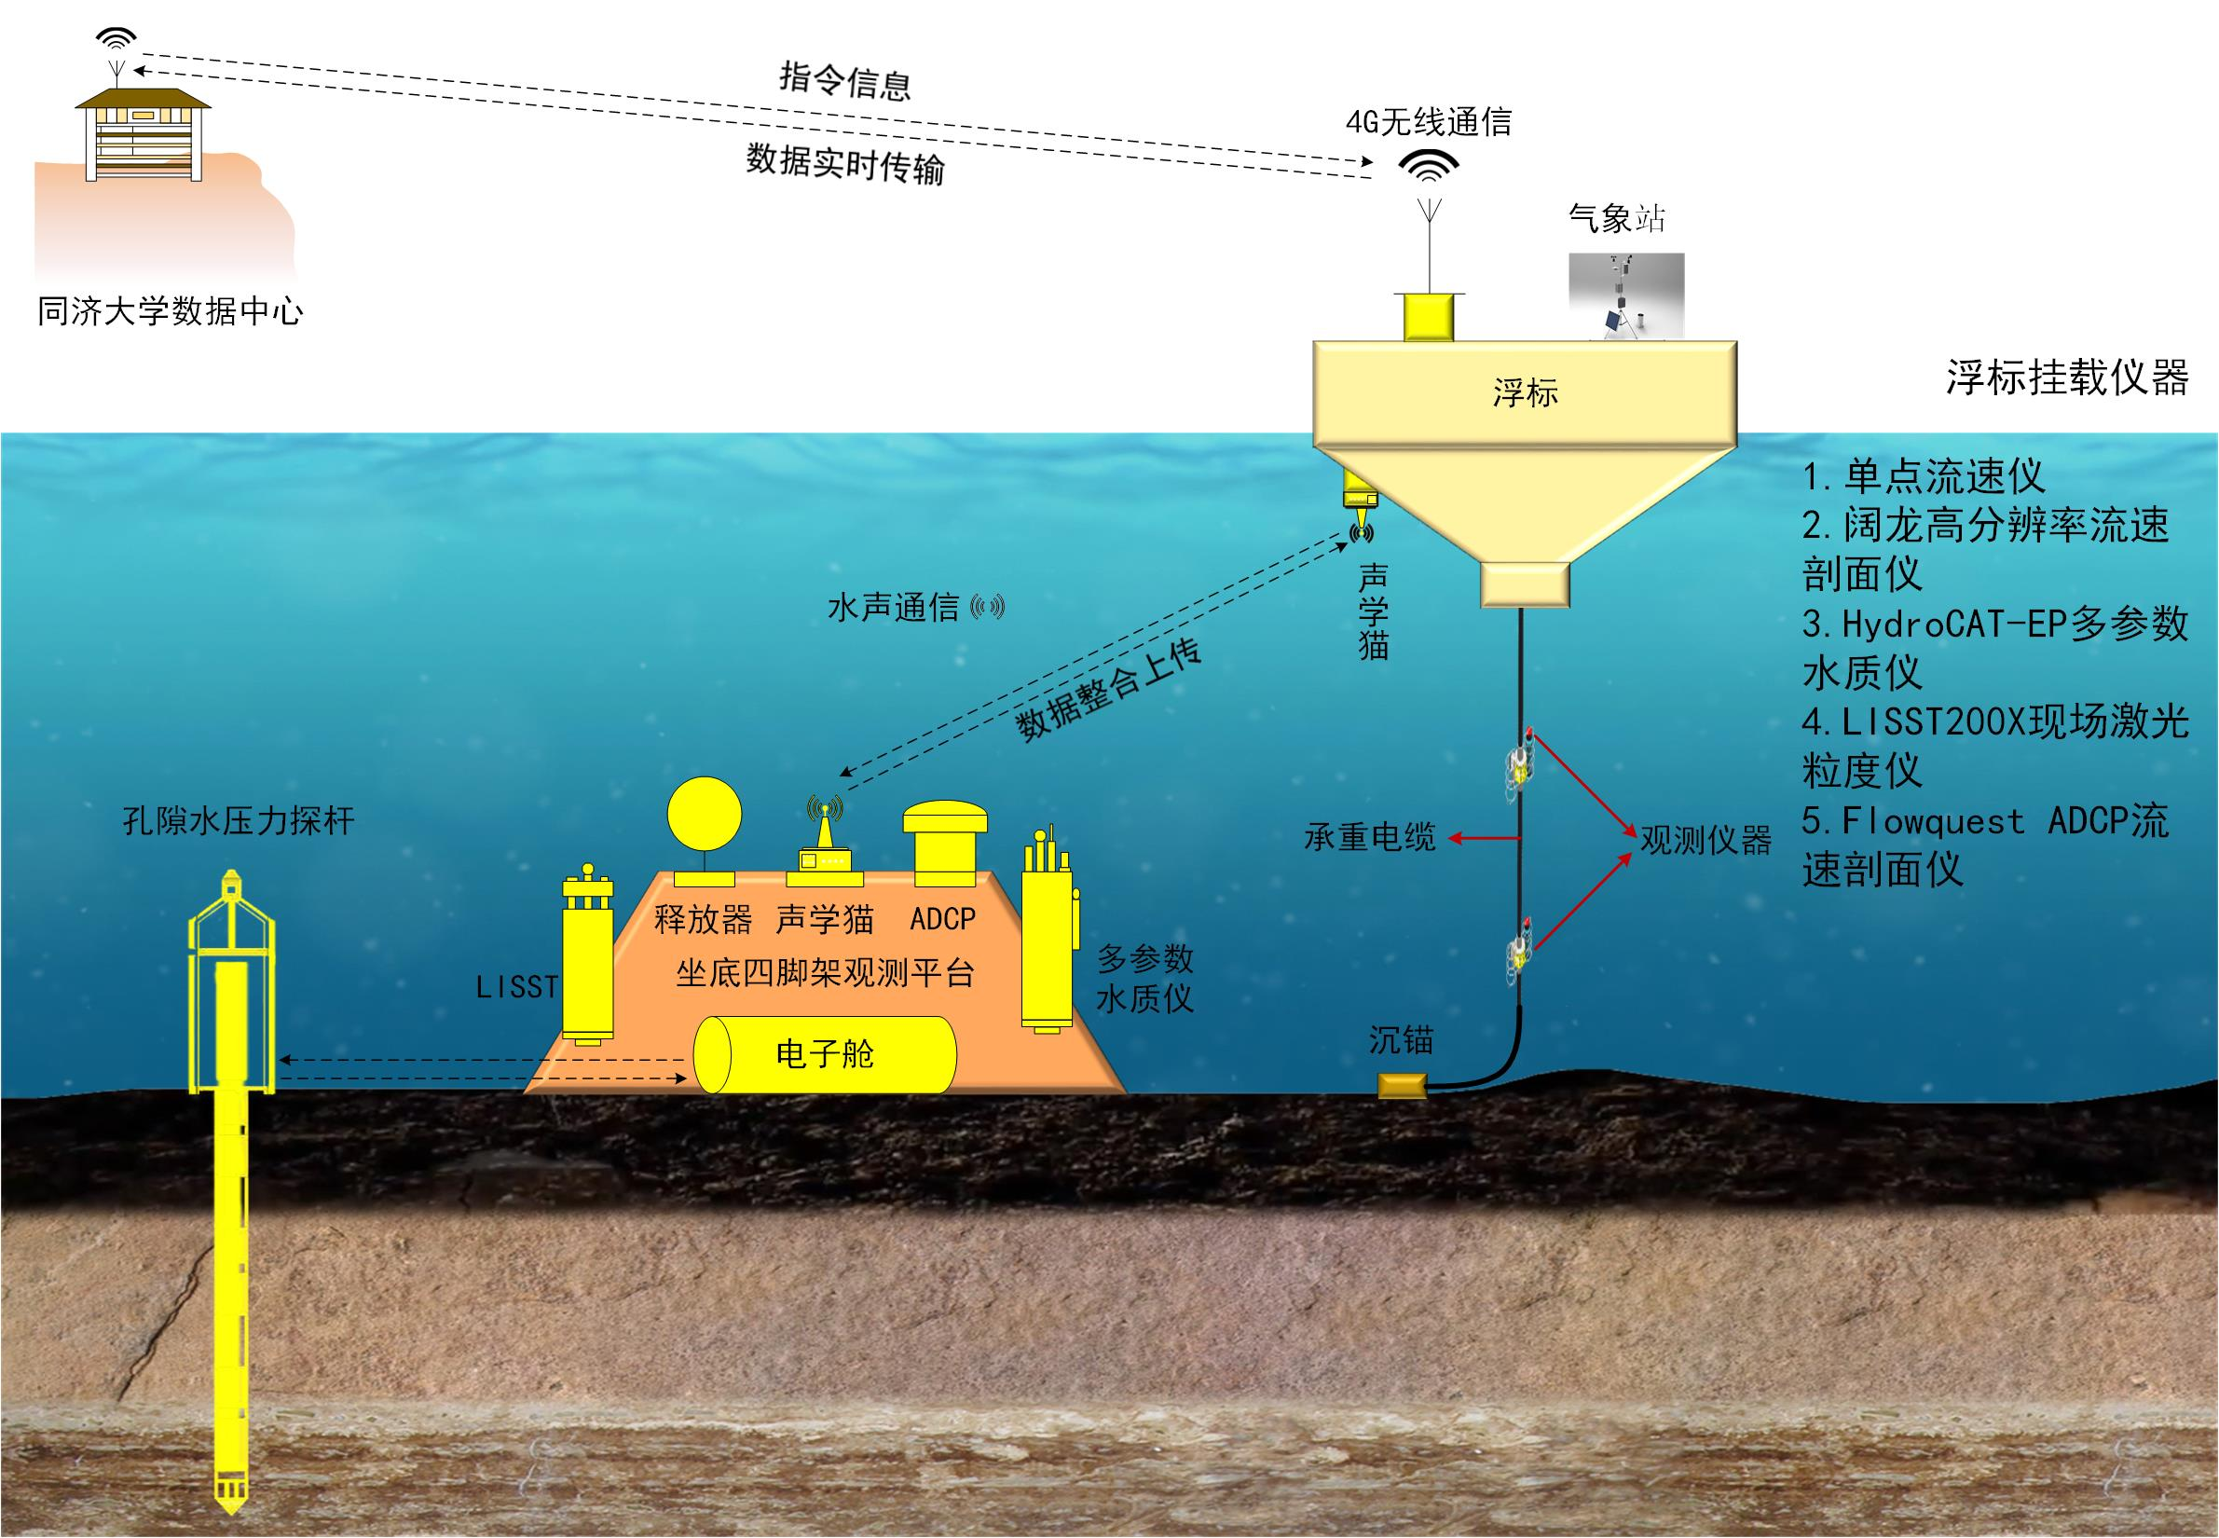
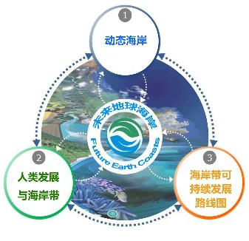
可移动的、实时的、立体的监测系统
海洋科学观测数据采集
水柱
浅表层土体
平台架构：浮标+三脚架+孔压探杆
通讯：电子舱+水声通讯+4G无线通讯或卫星通讯
供电：太阳能+蓄电池

Slide 19
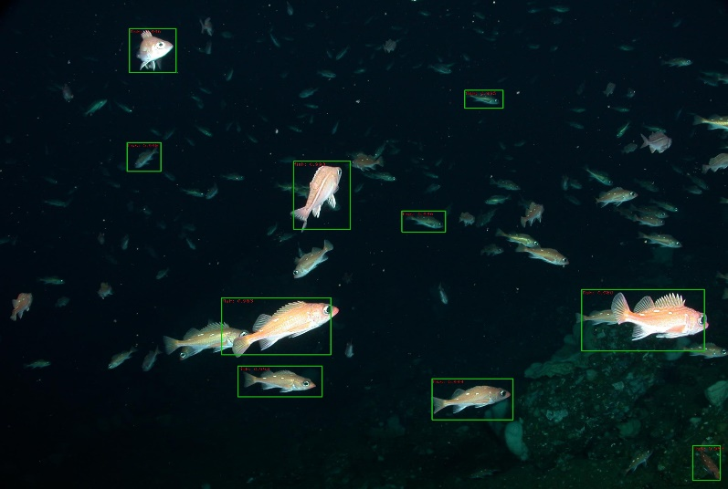
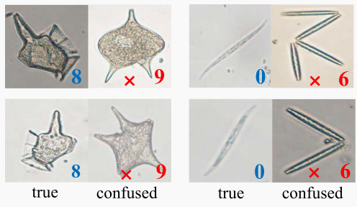
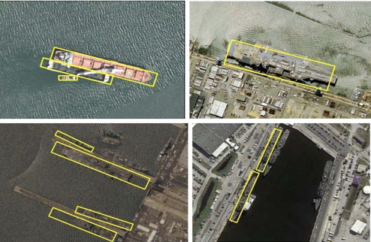
海洋大科学工程交叉研究
海洋生物识别、海面目标检测
针对海洋生物（鱼类和浮游生物）分类问题提出基于小样本的识别方法
提出一种新型的光学遥感图像目标检测方法，可用于海洋灾害监测

Slide 20
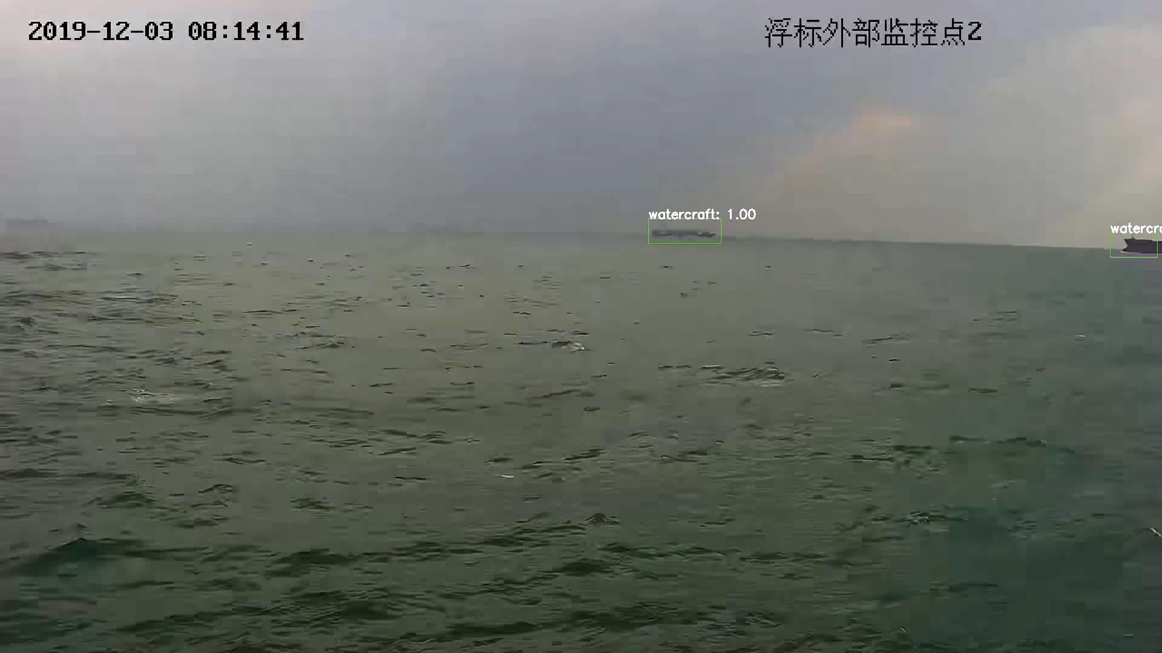
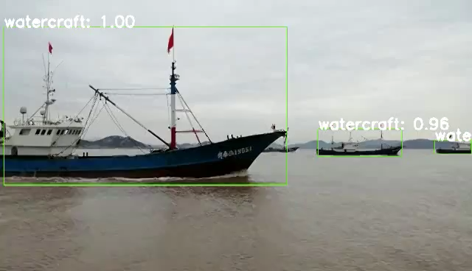
海洋大科学工程交叉研究
基于浮标监测数据的海面船只动态检测，有效解决了由于海面不平稳导致的相机晃动问题，以及天气、距离等因素造成的图像模糊问题，应用于海面船只预警系统

Slide 21
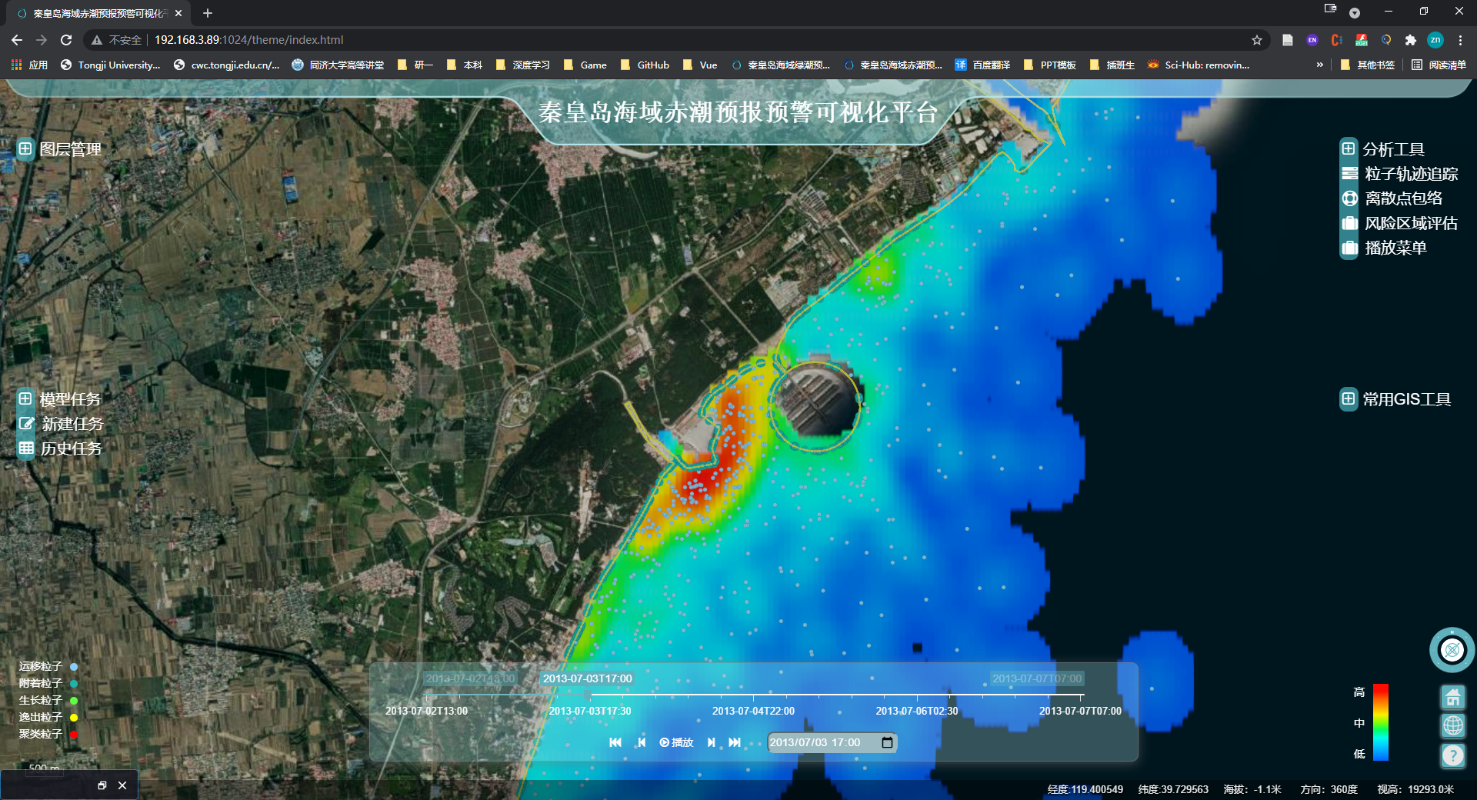
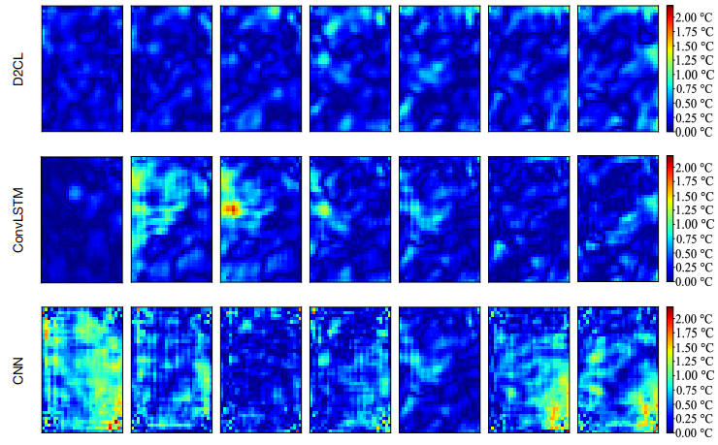
海洋大科学工程交叉研究
藻类风险评估、海温预测
基于粒子密度分布的赤潮风险评估（秦皇岛海域）
针对海洋时空数据提出的时空特征一体化提取模型，用于海面温度预测

Slide 22



城市水管网络故障点预测
研究城市防灾设施系统内和跨系统间的失效情景，并统计失效规律，建立关键要素与特征失效规律之间的关联映射。
利用空间统计方法，在 ArcGIS 中进行聚类分析、回归分析，构建防灾设施的空间布局和网络拓扑结构特征与典型失效规律之间的相关性
利用数理统计方法，挖掘防灾设施功能与典型失效规律之间的相关性。
项目来源
项目合作方

Slide 23
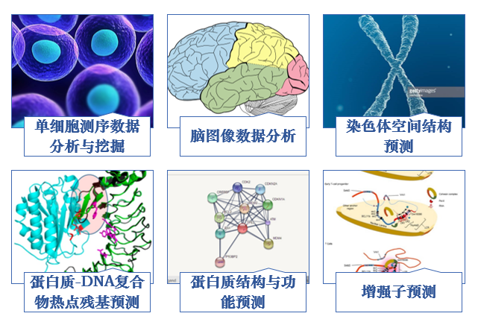

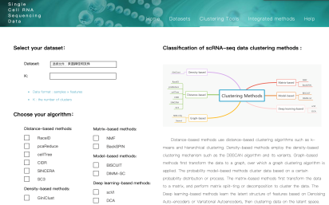


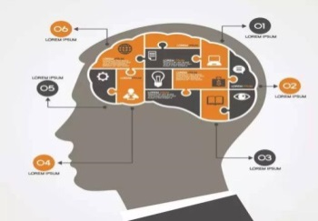
生物医学大数据分析与应用
研究问题
数据服务
细胞分化路径重建平台STREAM
蛋白质复合物热点预测
聚类分析平台scClust
辅助
辅助
生物制药
生命体功能认知

Slide 24



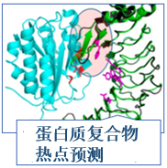
生物医学大数据分析与应用
数据类型 | 模型方法
图像 | 深度学习、变分自编码器，生成对抗网络、矩阵分解等
文本 | 无监督学习、词嵌入、自然语言处理等
序列 | 统计分析，长短期记忆机等
图 | 图卷积神经网络、图嵌入、子图划分等
医学影像
疾病
药物设计

Slide 25
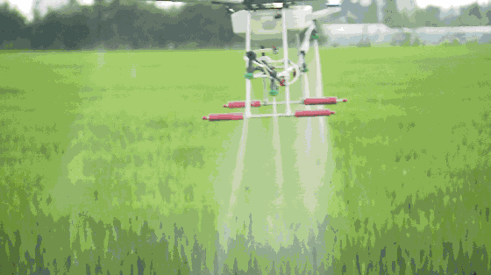
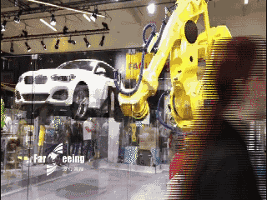
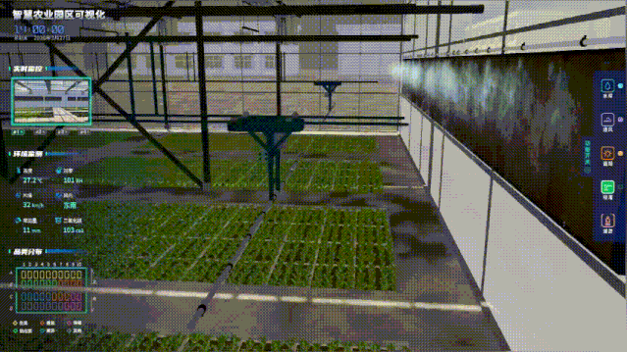



信息技术

Slide 26




大数据

Slide 27






AI

Slide 28



更快、更强、更灵活、更聪明

Slide 29






Slide 30

世界互联网大会,浙江乌镇
从2014年始每年一届，2022年7月12日，世界互联网大会国际组织总部设在中国北京。宗旨是搭建全球互联网共商共建共享平台，推动国际社会顺应数字化、网络化、智能化趋势，共迎安全挑战，共谋发展福祉，携手构建网络空间命运共同体。
人工智能、大数据、物联网等新技术新应用新业态方兴未艾，互联网迎来了更加强劲的发展动能和更加广阔的发展空间。发展好、运用好、治理好互联网，让互联网更好造福人类，是国际社会的共同责任。各国应顺应时代潮流，勇担发展责任，共迎风险挑战，共同推进网络空间全球治理，努力推动构建网络空间命运共同体。

Slide 31



人肉搜索（社会正义）
问题：侵害他人的隐私权、侵犯他人名誉权、干涉他人生活方式选择权、成为商业炒作和实现私利的工具

Slide 32






计算机技术的思考

Slide 33
Data
Data is a set of values of qualitative or quantitative variables.
描述事物的符号记录
Data is collected, stored and analyzed. It can be visualized using graphs, images and other analysis tools.
Data has been described as the new oil of Digital Economy(数字经济).
Data, information, knowledge and wisdom are closely related concepts, but each has its own role in relation to the others, and each term has its own meaning.

Slide 34
Data related concepts and technologies
Data related concepts and technologies
Data acquisition, Data modeling, Data structure
Data integrity, Data maintenance, Data management
Data analysis, Data mining, Data visualization, Data processing
Data publication, Data protection, Big Data, Data science
Data resources
Experimental data, Biological data, Environmental data, Transportation data, Industrial data, Economic data, …
Data set, Datasheet, Database，Data warehouse, Data mart, Data lake(数据湖), Data lakehouse(数据湖仓), Data middle office(数据中台)

Slide 35

Data warehouse, Data lake

Slide 36

Data warehouse vs. Data lake

Slide 37

Data warehouse, Data lake, Lakehouse

Slide 38

Application

Slide 39
某比萨店的电话铃响了，客服人员拿起电话。
客服：XXX比萨店。您好，请问有什么需要我为您服务 ？
顾客：你好，我想要一份……
客服：先生，烦请先把您的会员卡号告诉我。
顾客：16846146***。
客服：陈先生，您好！您是住在泉州路一号12楼120x室，请问您想要点什么？
顾客：我想要一个海鲜比萨……
客服：陈先生，海鲜比萨不适合您。
顾客：为什么？
客服：根据您的医疗记录，你的血压和胆固醇都偏高。
顾客：那你们有什么可以推荐的？
客服：您可以试试我们的低脂健康比萨。
顾客：你怎么知道我会喜欢吃这种的？
客服：您上星期一在中央图书馆借了一本《低脂健康食谱》。
顾客：好。那我要一个家庭特大号比萨，要付多少钱？
客服：99元，这个足够您一家六口吃了。但您母亲应该少吃，她上个月刚刚做了心脏搭桥手术，还处在恢复期。
顾客：那可以刷卡吗？
客服：陈先生，对不起。请您付现款，因为您的信用卡已经刷爆了，您现在还欠银行4807元，而且还不包括房贷利息
顾客：那我先去附近的提款机提款。
客服：陈先生，根据您的记录，您已经超过今日提款限额。
顾客：算了，你们直接把比萨送我家吧，家里有现金。你们多久会送到？
客服：大约30分钟。如果您不想等，可以自己骑车来。
顾客：为什么？
客服：根据我们全球定位系统的车辆行驶自动跟踪系统记录。您登记有一辆车号为XX-748的摩托车，而目前您正在解放路东段华联商场右侧骑着这辆摩托车。
顾客当即晕倒……
家庭住址
Big Data:A Joke
医疗记录
医疗记录
借阅记录
借贷记录
定位跟踪

Slide 40
Information & Information Retrieval
Information
Provide the answer to a question of some kind or resolves uncertainty. It is thus related to data and knowledge, as data represents values attributed to parameters, and knowledge signifies understanding of real things or abstract concepts.
Information retrieval (IR)
The activity of obtaining information from a collection of information resources. Searches can be based on full-text or other content-based indexing.

Slide 41

Knowledge  knowledge base + inference engine  Expert System
Knowledge
Familiarity, awareness, or understanding of someone or something, such as facts, information, descriptions, or skills. Knowledge is acquired through experience or education by perceiving, discovering, or learning.
In philosophy, the study of knowledge is called epistemology (认识论). Theories of knowledge, Communicating knowledge, Situated knowledge, Partial knowledge, Scientific knowledge, Religious meaning of knowledge.
“Knowledge is of two kinds: we know a subject ourselves, or we know where we can find information upon it.”
Samuel Johnson (1709-1784)

Slide 42
Intelligence Artificial Intelligence
Intelligence has been defined in many ways to include the capacity for logic, understanding, self-awareness, learning, emotional knowledge, reasoning, planning, creativity, and problem solving. It can be more generally described as the ability to perceive or infer information, and to retain it as knowledge to be applied towards adaptive behaviors within an environment or context.
Artificial intelligence (or AI) is both the intelligence of machines and the branch of computer science which aims to create it, through “the study and design of intelligent agents” or “rational agents”, where an intelligent agent is a system that perceives its environment and takes actions which maximize its chances of success. Achievements in artificial intelligence include constrained and well-defined problems such as games, crossword-solving and optical character recognition and a few more general problems such as autonomous cars.

Slide 43
Intelligence Artificial Intelligence
General intelligence or strong AI has not yet been achieved and is a long-term goal of AI research.
Researchers hope machines will exhibit are reasoning, knowledge, planning, learning, communication, perception, and the ability to move and to manipulate objects, how closely the brain should be simulated.
DeepMind: AlphaGo围棋, AlphaStar星际争霸游戏, 解数学题失败; 微软亚洲研究院的麻将AI系统Suphx(超级凤凰)成为首个在国际知名的专业麻将平台“天凤”上荣升十段的AI系统；Alphafold, AlphaFold2再登Nature，从业者都懵了：人类98.5%的蛋白质，全都被预测了一遍
ChatGPT/GPT4：MBA、Law考试……

Slide 44
Data Mining and Information Retrieval
Data Mining
Rules/patterns
Information Retrieval
Querying of unstructured textual data
属性筛选
属性重要性打分
主成分分析
特征选择
基于卡方检验的属性筛选
基于信息增益的属性打分
分类预测
决策树
神经网络分类
贝叶斯网络
逻辑回归
分类回归树
支持向量机
朴素贝叶斯
分类组合模型
数据挖掘
回归分析
多元线性回归
神经网络回归
广义线性回归
支持向量机回归
回归组合模型
聚类分析
K均值聚类
层次聚类
分布估计聚类
密度聚类
关联分析
购物篮分析
属性关联分析
序列模式分析
时间序列
ARMA时间序列
ARIMA时间序列

Slide 45
Data, Information, Knowledge
Knowledge
Knowledge
Pattern, Correlation
Complex analysis
Reports
Information
Simple analysis
Clean and integrated data
Clean and integrate
Data
Raw data: Large, low value, multi-sources

Slide 46
Data Processing Flow
Data Collection
Data Storage
Data Integration
Data Analysis
Data Visualization
Decision Making
Database
Warehouse
ETL
ETL: Extract, Transform and Load

Slide 47
What Is a Database System?
Database
a very large, integrated collection of data.
Database Management System (DBMS)
A software system designed to store, manage, and facilitate access to databases.
A Database System (DBS)
Hardware platform (PC/ Workstation/ Cluster/ Mainframe etc.)
DBMS
A (number of) database(s)
Human interface that is both convenient and efficient to use

Slide 48

Database Management System (DBMS)

Slide 49

Users
Applications/tools
Database
System
Structure
DBMS
Database

Slide 50


Why Study Databases?
Big Data
From Google trends (https://trends.google.com/trends), 2022/8/27

Slide 51



Why Study Databases?
Need for DBMS has exploded in the past years
Customer relationship mgmt (CRM), supply chain mgmt, Enterprise Resource Planning (ERP), Business intelligence(BI), etc.
Industry 4.0 (工业4.0), Made in China 2025(中国制造2025)

Slide 52


Why Study Databases?
Need for DBMS has exploded in the past years
Digital libraries, Human Genome project, Internet of things (IoT), Smart City, Smart Ocean, Autopilot, etc.
物联网
智慧城市

Slide 53

Why Study Databases?
DBMS encompasses much of CS in a practical discipline
OS, languages, theory, AI, multimedia, logic
Yet traditional focus on real-world apps

Slide 54






Why Study Databases?
CS
Chip
OS
DB

Slide 55
Course Objective 1
Learn and discuss the theoretical and technical approaches to database design and transaction management
Describe the development of DB systems to understand the architectures of commercially available systems
Design and build appropriate systems for applications requiring a database solution
Discuss the future directions of database technology in terms of design, hardware and software implementations

Slide 56
Course Objective 2
An opportunity to demonstrate the following skills
Understanding of a specific body of knowledge and skills
Assimilate, evaluate and analyze information as a result of independent and group research
Propose a solution to the practical problem, and make effective use of the time and available resources

Slide 57
Course Introduction
The indicative content can be described as follows:
An investigation of a solid grounding in the foundations of database technology from both theoretical and practical standpoint;
A broad introduction to the concepts of database systems in general and relational systems in particular, and the standard database language SQL;
Detailed discussions on the relational model, database design and transaction management;
and some further topics are discussed also.

Slide 58







Textbook
Abraham Silberschatz(耶鲁), Henry F. Korth(理海大学), and S. Sudarshan(印度理工学院), Database System Concepts
2010
2019

Slide 59



Textbook
Abraham Silberschatz(耶鲁), Henry F. Korth(理海大学), S. Sudarshan (印度理工学院), Database System Concepts (6th edition), 2011
中文版（第6版/第7版），北京大学杨冬青等译, 2012/2021

Slide 60




Textbook and References
Other References
Raghu Ramakrishnan and Johannes Gehrke, Database Management Systems (3rd Edition), McGraw-Hill, 2007/2012 CTO Microsoft
Jeffrey D. Ullman and Jennifer Widom, A First Course in Database Systems (3rd Edition), Prentice Hall, 2008
Date C J, An Introduction to Database System (8th edition), Addison-Wesley, 2003
Patrick O’Neil and Elizabeth O’Neil, Database: Principles, Programming, and Performance (2nd Edition), Morgan Kaufmann, 2000

Slide 61

Further about the Textbook and the First Author: Avi Silberschatz
Sidney J. Weinberg Professor of Computer Science & Chair of the Comp.Sci. Department at Yale University
a Fellow of the Association of Computing Machinery (ACM), a Fellow of Institute of Electrical and Electronic Engineerings (IEEE), a Fellow of the American Association for the Advancement of Science (AAAS), and a member of the Connecticut Academy of Science and Engineering.
http://codex.cs.yale.edu/avi/
Text book URL: http://www.db-book.com/

Slide 62
Outline of the Course
Part 0: Overview
Ch1: Introduction
Part 1 Relational Databases
Ch2: Relational model (data model, relational algebra)
Ch3&4: SQL(Structured Query Language)
Ch5: Advanced SQL
Part 2 Database Design
Ch6: Database design based on E-R model
Ch7: Relational database design
Part 3 Application Design & Development
Ch8: Complex data types
Ch9: Application development
Part 4 Big data analytics
Ch10: Big data
Ch11: Data analytics
Part 5 Data Storage & Indexing
Ch12: Physical storage system
Ch13: Data storage structure
Ch14: Indexing
Part 6 Query Processing & Optimization
Ch15: Query processing
Ch16: Query optimization
Part 7 Transaction Management
Ch17: Transactions
Ch18: Concurrency control
Ch19: Recovery system
Part 8 Parallel & Distributed Database
Ch20: Database system architecture
Ch21-23: Parallel & distributed storage, query processing & transaction processing
Part 9
DB Platform:OceanBase, MongoDB, Neo4J

Slide 63
Grading Scheme
Attendance & quiz (10%)
Final examination (30%)
Course projects (40%)
System design document
Miscellaneous (20%)
Group oral presentations & personal report (e.g., 蚂蚁OceanBase, 华为OpenGauss)
Lab reports
Assignments
Research (extra points: +10%)

Slide 64
Grading Scheme for Course Project (2024年春课程设计)
Project (70%)
System (50%): an application system, and a system report
Oral defense (20%)：mid term(10%) + final(10%)
Reports (20%)
Personal technical report
Case studies for 蚂蚁OceanBase, 华为OpenGauss, PostgreSQL, MySQL, NoSQL…
Research paper
Attendance (10%)
Research
Extra points: +10%

Slide 65
Other Useful Materials
Conferences Proceedings
SIGMOD / PODS, VLDB, ICDE
ICDT, EDBT, ER, DEXA, DASFAA, SSTD, etc.
Journals
ACM Transactions on Database Systems (TODS)
IEEE Trans. on Knowledge and Data Engineering (TKDE)
VLDB Journal
Data and Knowledge Engineering (DKE), etc.
The Internet resources
DBLP: http://dblp.uni-trier.de/
Google Scholar, Citeseer, etc.

Slide 66
Other Useful Materials
Wechat (微信)关注
数据分析精选
大数据
大数据文摘
互联网分析沙龙
网络数据大全
数据分析
战略前沿技术
大数据魔方
……

Slide 67

Suggestion
课程QQ群
教辅答疑
发布通知
交流分享

Slide 68
开展小组/个人专题研究与讨论报告
研究对象（国产数据库）：蚂蚁OceanBase或华为OpenGauss
Storage: 存储, Traditional + Cloud
Index: 索引, Traditional + Spatial
Query: 查询, Traditional + Complex
Optimization: 优化, Different levels, strategies, techniques
Transactions: 事务处理，并发，恢复
Distributed DB: 分布数据库
Advanced topics
Big Data, BlockChain, AI4DB, DB4AI, …

Slide 69
Punishment Policy
Plagiarism or cheating in assignments, course projects, and examinations is absolutely unacceptable. Once found, your grade will be definitely set to Fail ! NO ChatGPT/GPT!

Slide 70






“五守”
守时
守纪
遵守规定的时间
生活中遵守作息时间，学习中遵守课表时间，日常生活中遵守约定时间。
遵守纪律
遵守各项校规校纪，特别是日常行为规范和考试纪律。
守序
遵守秩序
集体活动中遵守排队秩序，日常生活中维护公共场所秩序，校外活动中遵守公共秩序。
五守
同济大学学生行为规范
守法
守信
信守承诺
爱惜自己的信用记录，遵守承诺的事情，做诚信学子。
遵守国家法律
在校期间遵守法律规定的各项要求，在走出校园后，恪守法律法规。

Slide 71
End of Lecture 0

